Slide 1


AtliQ Hardware
Sales & Financial Analytics (2019–2021)
From Raw Data to Executive Insights
Presenter: Nayan Jyoti Baishya

Slide 2

Project Objective & Scope
Empowering Data-Driven Decisions
Objective
To design and develop a robust reporting system that tracks Atliq Hardware's global sales performance, and financial health.
Scope of Development
Consolidation of multi-year data (2019-2021).
Creation of distinct views for Sales (customer, division, geography, product) and Finance (P&L statements).
Establishment of performance benchmarks against predefined targets.

Slide 3
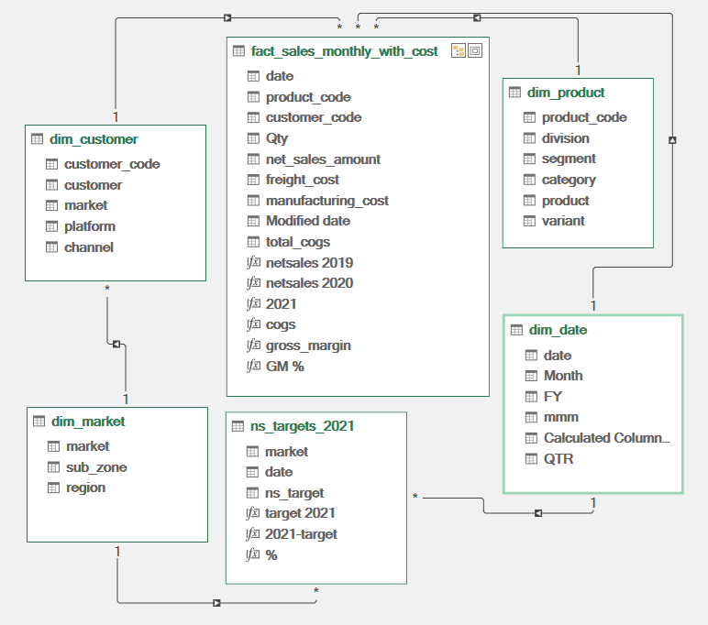
Data Architecture & Structuring
Building the Foundation
Process
Transformed raw transaction logs into structured datasets suitable for advanced analytics.
Key Dimensions Established
Time Intelligence: Fiscal years, quarters, and monthly granular reporting.
Geographical Mapping: Region, Market, and Country-level hierarchies.
Product Hierarchy: Divisions (N&S, P&A, PC), product categories, and individual SKUs.

Slide 4


Developing the Sales View
Tracking Revenue Drivers
Report Structure
Designed to isolate top-line growth metrics across multiple axes.
Key Reports Developed
Customer Performance: Tracking platform growth (e.g., Amazon, Flipkart, Atliq e-Store).
Division Growth: Year-over-year comparative analysis across PC, P&A, and N&S divisions.
Market vs. Target: A variance analysis report calculating the exact deficit/surplus against 2021 revenue goals.

Slide 5

Developing the Finance View
Architecting the P&L Statements
Report Structure
Built to provide visibility into operational efficiency and profitability.
Key Reports Developed
Net Sales: Deducting discounts and returns from gross revenue.
COGS (Cost of Goods Sold): Tracking the direct costs attributable to hardware production.
Gross Margin (GM) & GM%: Formulated to monitor profitability trends over time, ensuring that volume growth translates to actual business value.

Slide 6

Insight 1 - Explosive Top-Line Growth
Scaling Revenue from 2019 to 2021
The Data
Net sales grew from $87.4M in 2019 to an impressive $598.8M in 2021.
2021 saw a ~204% year-over-year growth compared to 2020 ($196.6M).
Takeaway
The company is in a phase of hyper-growth, successfully scaling its operations and market penetration over a three-year window.

Slide 7
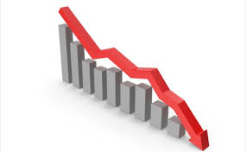
Insight 2 - The Profitability Squeeze
Scaling Revenue from 2019 to 2021
The Data
Despite massive revenue growth, the Gross Margin percentage (GM%) has steadily declined.
GM% dropped from 41.4% in 2019 to 37.2% in 2020, and further down to 36.4% in 2021.
Takeaway
Cost of Goods Sold (COGS) is rising faster than pricing adjustments can compensate. The company is trading margin for market share.
Gross Margin %
Gross Margin %

Slide 8

Insight 3 - Geographic Performance & Missed Targets
Scaling Revenue from 2019 to 2021
The Data
Top Performers (2021): India leads massively with $161.2M, followed by the USA ($87.7M) and South Korea ($48.9M).
Target Variance: Several key markets missed their 2021 targets. For example, Canada missed by -$5.06M (-14.4%), and Poland missed by -$940K (-18.1%).
Takeaway
While the absolute numbers in top markets are strong, forecasting and execution in secondary markets require strategic realignment.

Slide 9
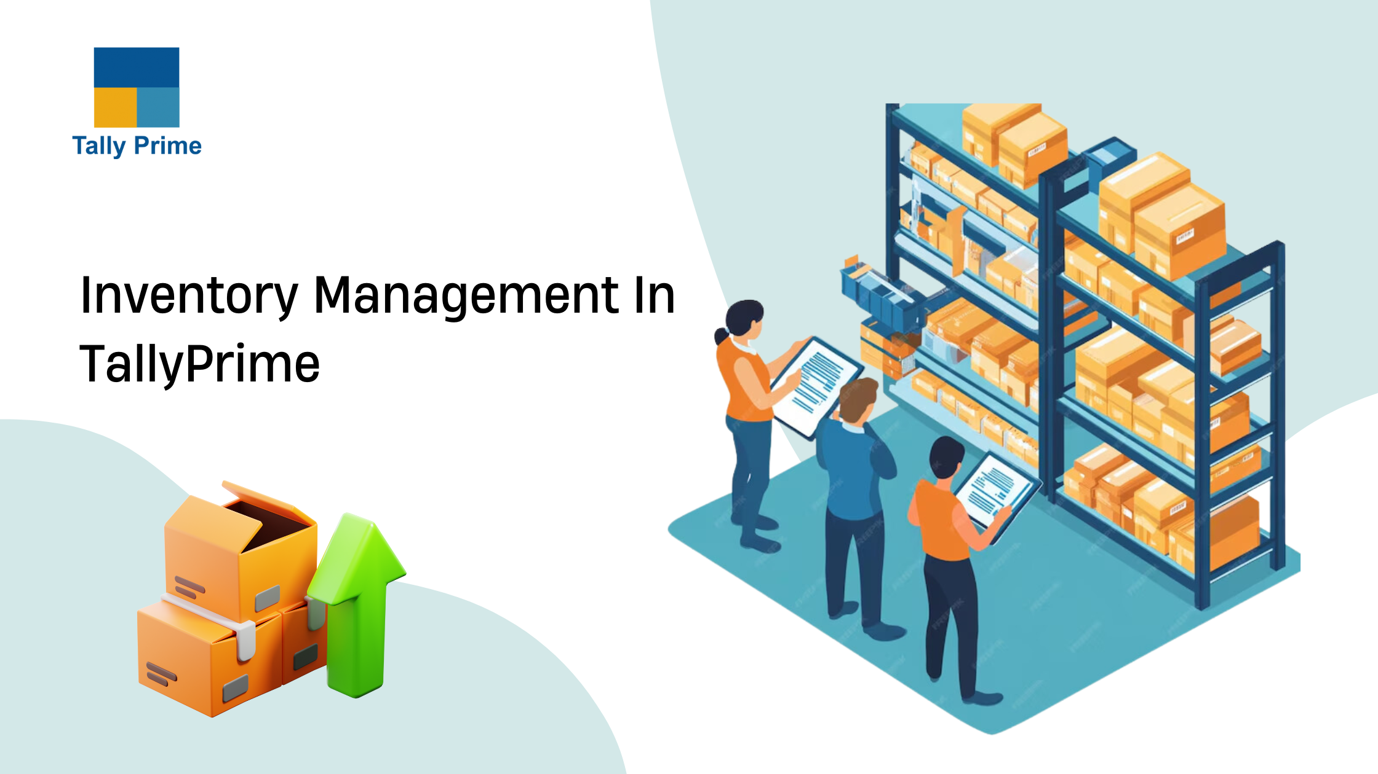
Insight 4 - Product Innovation & Volume
The Data
New Releases: Products launched in 2021 generated a staggering $176.1M in new revenue (e.g., AQ Qwerty, AQ Trigger).
Volume Drivers: The "AQ Gamers" and "AQ Master" series dominate in pure unit volume (over 3M-4M units each).
Takeaway
Rapid R&D and new product deployment are critical engines for Atliq's revenue model, successfully capturing consumer interest in the gaming and PC accessory segments.
The Impact of New Stock Keeping Units (SKUs)

Slide 10

Strategic Recommendations
Actionable Next Steps
Supply Chain Optimization: Conduct a deep dive into the rising COGS to arrest the declining Gross Margin %.
Target Realignment: Investigate why established markets like Canada and Spain underperformed against their 2021 targets, adjusting sales strategies accordingly.
Portfolio Management: Phase out bottom-performing products (e.g., AQ HOME Allin1 Gen 2) to reallocate manufacturing bandwidth to high-margin or high-volume items.

Slide 11


